Slide 1
Review of Java Fundamentals
© 2011 Pearson Addison-Wesley. All rights reserved
1-‹#›
Notes:
‹#›

Slide 2
Samples/ReviewJava
© 2011 Pearson Addison-Wesley. All rights reserved
1-‹#›

Slide 3
Java document: http://docs.oracle.com/javase/8/docs/api/
IntelliJ IDEA: https://www.jetbrains.com/idea/
Eclipse: http://www.eclipse.org/downloads/
Code Convention: http://www.oracle.com/technetwork/java/codeconventions-150003.pdf
© 2011 Pearson Addison-Wesley. All rights reserved
1-‹#›

Slide 4
Language Basics
Java application
Collection of classes
One class contains the main method
© 2011 Pearson Addison-Wesley. All rights reserved
1-‹#›
Notes:
‹#›

Slide 5
Comments
Comments
// Single line comment
/*
Multiple-line comments
*/
javadoc comments
/**
javadoc comments
*/
© 2011 Pearson Addison-Wesley. All rights reserved
1-‹#›
Notes:
‹#›

Slide 6
Identifiers and Keywords
Identifier (Tên: biến, phương thức, lớp)
Sequence of letters, digits, underscores, and dollar signs
Must begin with either a letter or underscore
Used to name various parts of the program
Java distinguishes between uppercase and lowercase letters
Examples
int nRow = sc.nextInt();
int nColumn = sc.nextInt();
Keywords (Từ khóa) or reserved identifiers
if else for while do static public private class enum...
void int double float boolean char
© 2011 Pearson Addison-Wesley. All rights reserved
1-‹#›
Notes:
‹#›

Slide 7
Variables (Biến)
Represents a memory location
Contains a value of primitive type or a reference
Its name is a Java identifier
Declared by preceding variable name with data type
double radius; // radius of a sphere
String name; // reference to a String object
© 2011 Pearson Addison-Wesley. All rights reserved
1-‹#›
Notes:
‹#›

Slide 8
Primitive Data Types (Kiểu dữ liệu cơ bản)
Organized into four categories
Boolean
Character
Integer
Floating point
Character and integer types are called integral types
Integral and floating-point types are called arithmetic types
© 2011 Pearson Addison-Wesley. All rights reserved
1-‹#›
Notes:
‹#›

Slide 9
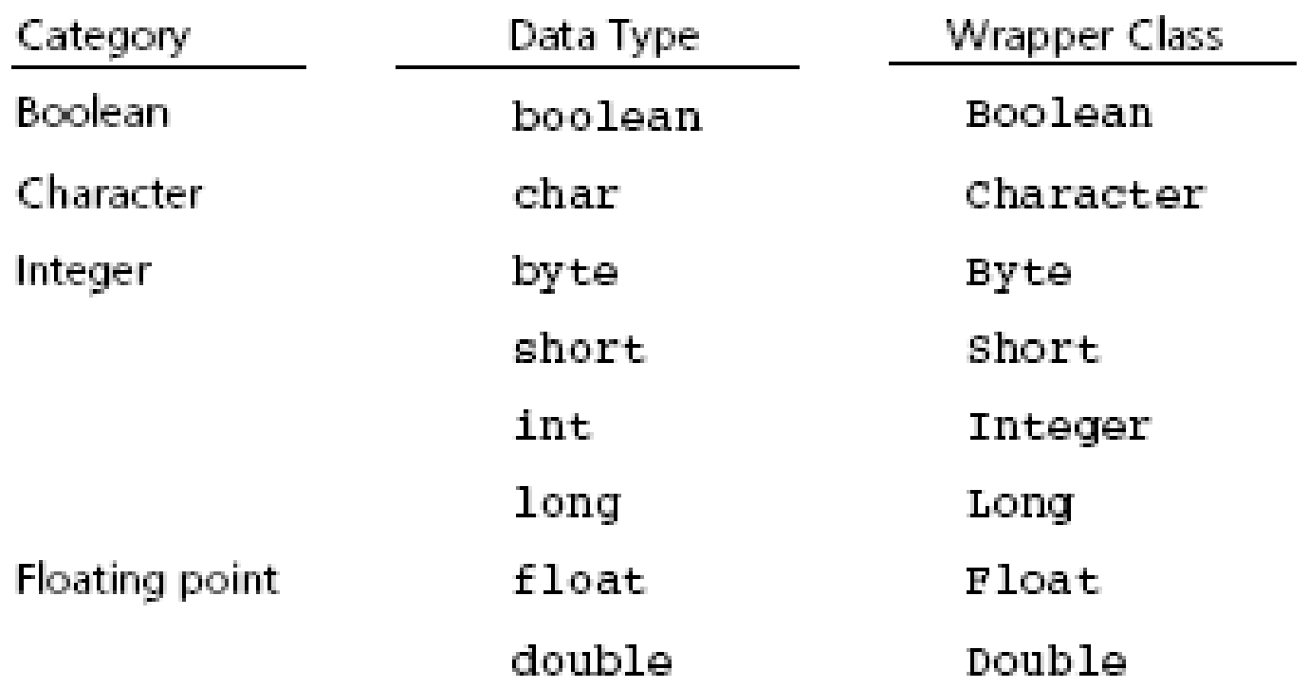
Primitive Data Types
Figure 1-5 Primitive data types and corresponding wrapper classes
© 2011 Pearson Addison-Wesley. All rights reserved
1-‹#›
Notes:
‹#›

Slide 10
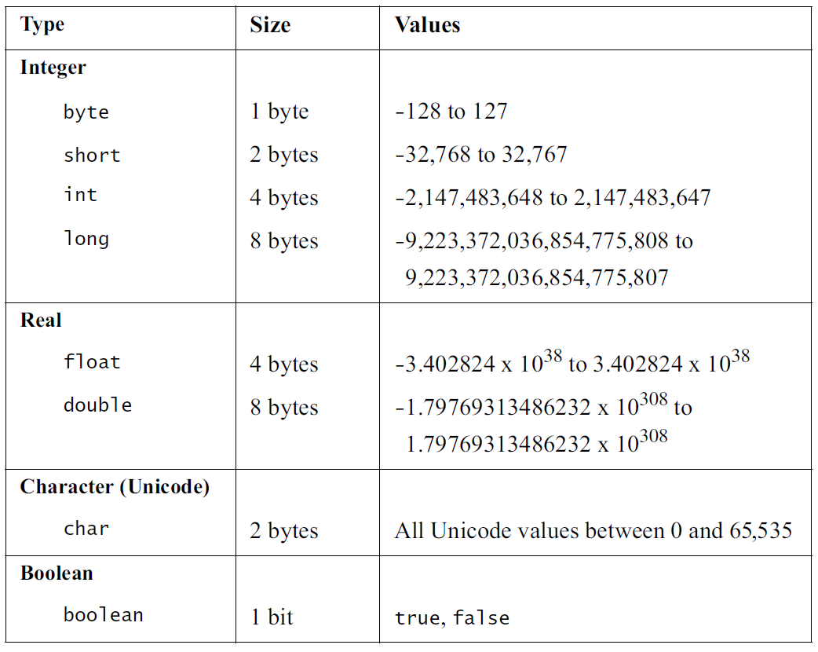
Primitive Data Types
Figure 1-5 Primitive data types and corresponding wrapper classes
© 2011 Pearson Addison-Wesley. All rights reserved
1-‹#›
Notes:
‹#›

Slide 11
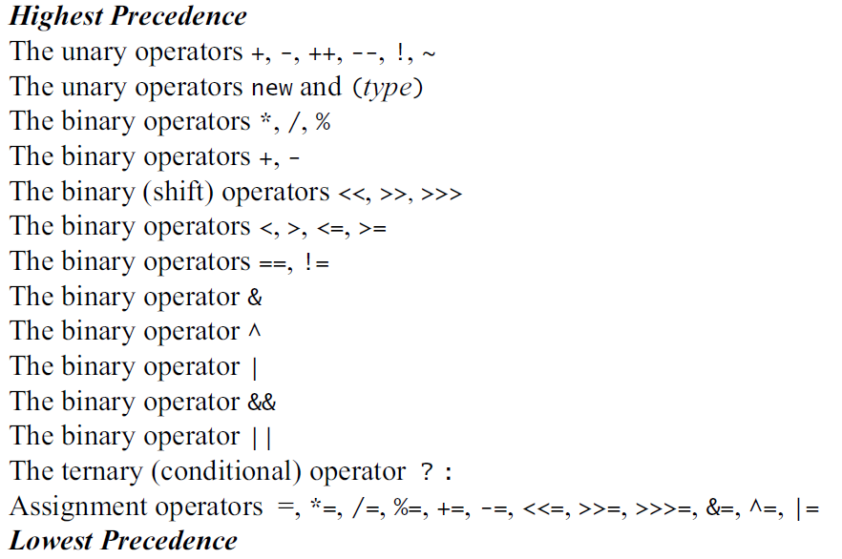
Operators

Slide 12
Assignments and Expressions
Expressions (Biểu thức)
Combination of variables, constants, operators, and parentheses
Assignment (Gán) statement
Example: radius = r;
Arithmetic (Toán học) expression
Combine variables and constants with arithmetic operators and parentheses
Arithmetic operators: *, /, %, +, -
© 2011 Pearson Addison-Wesley. All rights reserved
1-‹#›
Notes:
‹#›

Slide 13
Assignments and Expressions
Relational (Quan hệ) expressions
Combine variables and constants with relational, or comparison, and equality operators (Toán tử) and parentheses
Relational or comparison operators: <, <=, >=. >
Equality operators: ==, !=
Evaluate to true or false
© 2011 Pearson Addison-Wesley. All rights reserved
1-‹#›
Notes:
‹#›

Slide 14
Assignments and Expressions
Logical expressions
Combine variables and constants of arithmetic types, relational expressions with logical operators
Logical operators: &&, ||
Evaluate to true or false
© 2011 Pearson Addison-Wesley. All rights reserved
1-‹#›
Notes:
‹#›

Slide 15
Assignments and Expressions
Implicit type conversions (Chuyển kiểu ngầm định)
Occur during assignment and during expression evaluation
Right-hand side of assignment operator is converted to data type of item on left-hand side
Floating-point values are truncated not rounded
Integral promotion
Values of type byte, char, or short are converted to int
Conversion hierarchy
int → long → float → double
int n = 5;
long l = n;
float f = n;
© 2011 Pearson Addison-Wesley. All rights reserved
1-‹#›
Notes:
‹#›

Slide 16
Assignments and Expressions
Explicit type conversions (Chuyển kiểu tường minh)
Possible by means of a cast
Cast operator
Unary operator
Formed by enclosing the desired data type within parentheses
int n = 5;
float f = (float) n / 7;
int m = (int) (f * 10);
System.out.format("f: %.3f - m: %d", f, m);
© 2011 Pearson Addison-Wesley. All rights reserved
1-‹#›
Notes:
‹#›

Slide 17
Assignments and Expressions
int n = 5;
float value = n / 7 * 10;
© 2011 Pearson Addison-Wesley. All rights reserved
1-‹#›
Notes:
‹#›

Slide 18
Assignments and Expressions
Other assignment operators
-=
*=
/=
%=
++
--
© 2011 Pearson Addison-Wesley. All rights reserved
1-‹#›
Notes:
‹#›

Slide 19
public void changeName(Student s) {
s.name = s.name + "_EIU";
}
int i = 10;
Student s = new Student("Tuan", new Date(), "tuan@eiu.edu.vn");
int n = i;
n = n + 1; // i = ?
Student t = s;
t.name = "Hanh"; // s.name = ?
changeName(s); // s.name = ? t.name = ?
int[] numbers = new int[] { 0, 1, 2, 3, 4, 5, 6, 7, 8, 9 };
int[] list = numbers;
list[5] += 10; // numbers[5] = ? // list[5] = ?
1-‹#›

Slide 20
String name = "Thanh";
name.toLowerCase();
name.replaceAll(“thanh", "Ngoc");
// name = ?
© 2011 Pearson Addison-Wesley. All rights reserved
1-‹#›

Slide 21
Arrays
Collection of elements with the same data type
Array elements have an order
Support direct and random access
One-dimensional arrays
Declaration example
final int DAYS_PER_WEEK = 7;
double [] maxTemps = new double[DAYS_PER_WEEK];
Length of an array is accessible using data field length
Use an index or subscript to access an array element
© 2011 Pearson Addison-Wesley. All rights reserved
1-‹#›
Notes:
‹#›

Slide 22
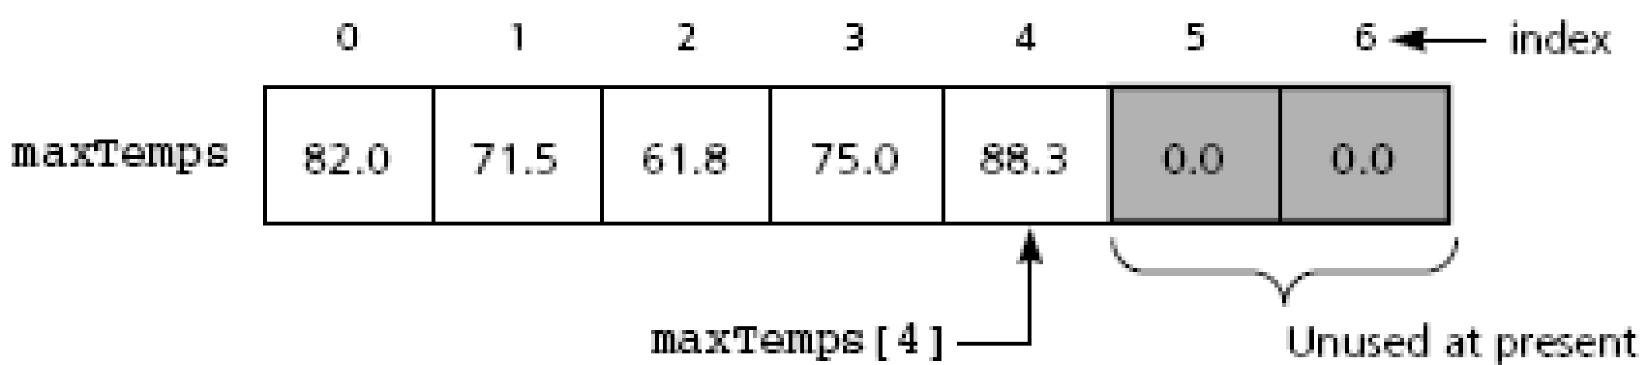
Arrays
Figure 1-7 One-dimensional array of at most seven elements
© 2011 Pearson Addison-Wesley. All rights reserved
1-‹#›
Notes:
‹#›

Slide 23
Arrays
One-dimensional arrays (continued)
Initializer list example
double [] weekDayTemps = {82.0, 71.5, 61.8, 75.0, 88.3};
You can also declare array of object references
Multidimensional arrays
final int DAYS_PER_WEEK = 7;
final int WEEKS_PER_YEAR = 52;
double[][] minTemps = new double[DAYS_PER_WEEK][WEEKS_PER_YEAR];
© 2011 Pearson Addison-Wesley. All rights reserved
1-‹#›
Notes:
‹#›

Slide 24
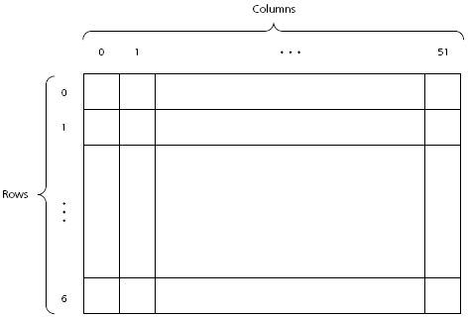
Arrays
Figure 1-8
A two-dimensional array
© 2011 Pearson Addison-Wesley. All rights reserved
1-‹#›
Notes:
‹#›

Slide 25
int[] numbers = new int[] { 0, 1, 2, 3, 4, 5, 6, 7, 8, 9 };
int[] list = numbers;
list[5] += 10; // numbers = ? // list = ?
int[][] matrix =
new int[][] { { 0, 1, 2, 3 }, { 0, 1 },
{ 0, 1, 2 }, { 0, 1, 2, 3, 4, 5 } };
1-‹#›

Slide 26
Selection Statements
The if statement
if (expression)
statement1
or
if (expression)
statement1
else
statement2
Nested if
if (expression) {
statement1
}
else if (expression) {
statement2
}
else {
statement3
} // end if
© 2011 Pearson Addison-Wesley. All rights reserved
1-‹#›
Notes:
‹#›

Slide 27
Selection Statements
The switch statement
switch (integral expression) {
case 1:
statement1;
break;
case 2, case 3:
statement2;
case 4:
statement3;
break;
default:
statement4;
} //end of switch
© 2011 Pearson Addison-Wesley. All rights reserved
1-‹#›
Notes:
‹#›

Slide 28
int i = 10;
switch (i) {
case 0:
break;
}
switch (name) {
case "Ngoc":
break;
}
Student s = new Student("Tuan", new Date(), "tuan@eiu.edu.vn");
Student t = s;
switch (s) {
case t:
break;
}
© 2011 Pearson Addison-Wesley. All rights reserved
1-‹#›

Slide 29
Iteration Statements
The for statement
for (initialize; test; update)
statement
statement is executed as long as test is true
for statement is equivalent to a while statement
© 2011 Pearson Addison-Wesley. All rights reserved
1-‹#›
Notes:
‹#›

Slide 30
Iteration Statements
The while statement
while (expression) {
statement
}
statement is executed as long as expression is true
statement may not be executed at all
continue expression
Stops the current iteration of the loop and begins the next iteration at the top of the loop
© 2011 Pearson Addison-Wesley. All rights reserved
1-‹#›
Notes:
‹#›

Slide 31
Iteration Statements
The do statement
do {
statement
} while (expression);
statement is executed until expression is false
do statement loops at least once
© 2011 Pearson Addison-Wesley. All rights reserved
1-‹#›
Notes:
‹#›

Slide 32
for(name = "One"; name != "Ngoc"; name.replace("One", "Ngoc")){
}
// What will happen
for(;;){
}
// What will happen
© 2011 Pearson Addison-Wesley. All rights reserved
1-‹#›

Slide 33
Program Structure
Typical Java program consists of
User written classes
Java application
Has one class with a main method
Java program basic elements:
Packages
Classes
Data fields (Trường dữ liệu)
Methods (Phương thức)
© 2011 Pearson Addison-Wesley. All rights reserved
1-‹#›
Notes:
‹#›

Slide 34
Packages
import statement
Allows you to use classes contained in other packages
import java.util.*;
Arrays.sort(numbers);
© 2011 Pearson Addison-Wesley. All rights reserved
1-‹#›
Notes:
‹#›

Slide 35
Classes
Data type that specifies data and methods available for instances of the class
An object in Java is an instance of a class
© 2011 Pearson Addison-Wesley. All rights reserved
1-‹#›
Notes:
‹#›

Slide 36
Classes
new operator
Creates an object or instance of a class
© 2011 Pearson Addison-Wesley. All rights reserved
1-‹#›
Notes:
‹#›

Slide 37
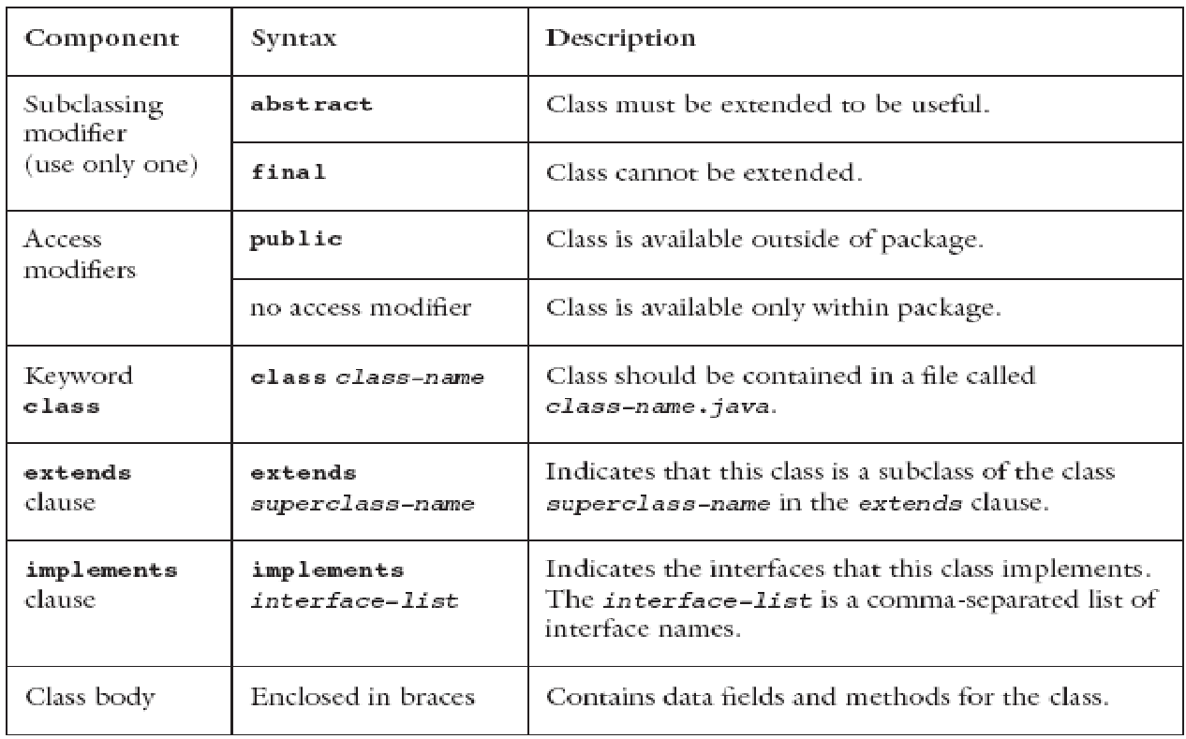
Classes
Figure 1-2 Components of a class
© 2011 Pearson Addison-Wesley. All rights reserved
1-‹#›
Notes:
‹#›

Slide 38
Data Fields
Class members that are either variables or constants
Data field declarations can contain
Access modifiers
Use modifiers
Modules
© 2011 Pearson Addison-Wesley. All rights reserved
1-‹#›
Notes:
‹#›

Slide 39
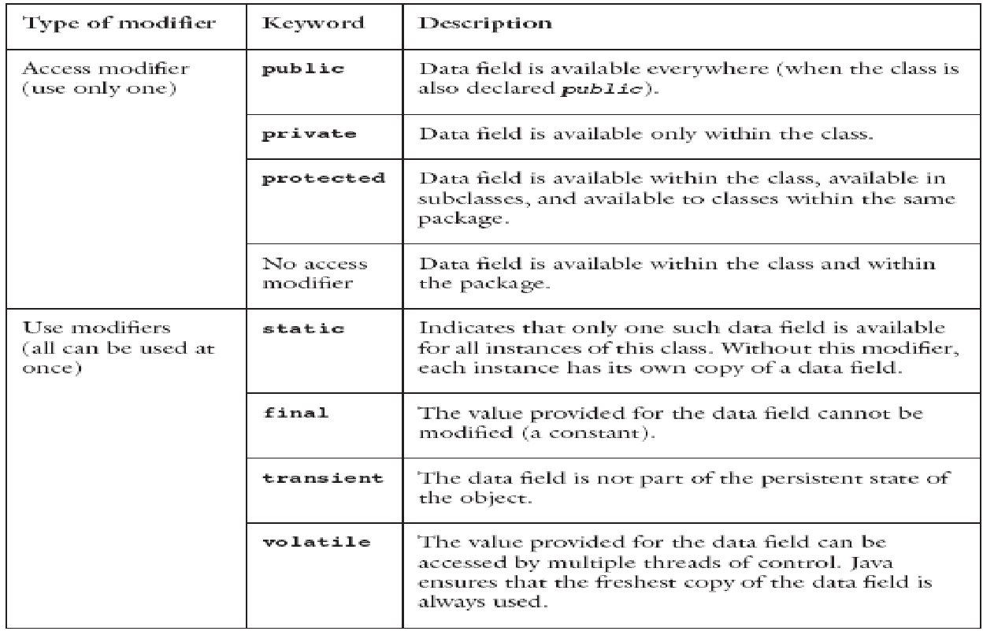
Data Fields
Figure 1-3 Modifiers used in data field declarations
© 2011 Pearson Addison-Wesley. All rights reserved
1-‹#›
Notes:
‹#›

Slide 40
Methods
Used to implement operations
Should perform one well-defined task
Method modifiers
Access modifiers and use modifiers
Valued method
Returns a value
Body must contain return expression;
© 2011 Pearson Addison-Wesley. All rights reserved
1-‹#›
Notes:
‹#›

Slide 41
Methods
Syntax of a method declaration
access-modifier use-modifiers return-type
method-name (formal-parameter-list) {
method-body
}
Arguments are passed by value
Except for objects and arrays
A reference value is copied instead
© 2011 Pearson Addison-Wesley. All rights reserved
1-‹#›
Notes:
‹#›

Slide 42
Methods
Constructor
Special kind of method
Has the same name as the class and no return type
Executed only when an object is created
A class can contain multiple constructors
© 2011 Pearson Addison-Wesley. All rights reserved
1-‹#›
Notes:
‹#›

Slide 43
How to Access Members of an Object
Data fields and methods declared public
Name the object, followed by a period, followed by member name
Members declared static
Use the class name, followed by a period, followed by member name
© 2011 Pearson Addison-Wesley. All rights reserved
1-‹#›
Notes:
‹#›

Slide 44
Useful Java Classes
The Arrays class
import java.util.Arrays;
Contains static methods for manipulating arrays
Commonly used examples
Sort (does it in ascending order)
Binary search (quickly finds a value in the array)
toString
Example: Let’s say a is an array of 1000 ints
Arrays.sort(a);
© 2011 Pearson Addison-Wesley. All rights reserved
1-‹#›

Slide 45
Useful Java Classes
String classes
Class String
Declaration examples:
String title;
String title = “Walls and Mirrors”;
Assignment example:
Title = “Walls and Mirrors”;
String length example:
title.length();
Referencing a single character
title.charAt(0);
Comparing strings
title.compareTo(string2);
© 2011 Pearson Addison-Wesley. All rights reserved
1-‹#›
Notes:
‹#›

Slide 46
Useful Java Classes
String classes (continued)
Class String
Concatenation example:
String monthName = "December";
int day = 31;
int year = 02;
String date = monthName + " " + day + ", 20" + year;
© 2011 Pearson Addison-Wesley. All rights reserved
1-‹#›
Notes:
‹#›

Slide 47
Text Input and Output
Input and output consist of streams
Streams
Sequence of characters that either come from or go to an I/O device
InputStream - Input stream class
PrintStream - Output stream class
java.lang.System provides three stream variables
System.in – standard input stream
System.out – standard output stream
System.err – standard error stream
© 2011 Pearson Addison-Wesley. All rights reserved
1-‹#›
Notes:
‹#›

Slide 48
Input
Character streams
BufferedReader stdin = new BufferedReader(new InputStreamReader(System.in));
String nextLine = stdin.readLine();
StringTokenizer input = new StringTokenizer(nextLine);
x = Integer.parseInt(input.nextToken());
y = Integer.parseInt(input.nextToken());
© 2011 Pearson Addison-Wesley. All rights reserved
1-‹#›
Notes:
‹#›

Slide 49
Input
Another approach: the Scanner class
int nextValue;
int sum=0;
Scanner kbInput = new Scanner(System.in);
nextValue = kbInput.nextInt();
while (nextValue > 0) {
sum += nextValue;
nextValue = kbInput.nextInt();
} // end while
kbInput.close();
© 2011 Pearson Addison-Wesley. All rights reserved
1-‹#›
Notes:
‹#›

Slide 50
Input
The Scanner class (continued)
More useful next methods
String next();
boolean nextBoolean();
double nextDouble();
float nextFloat();
int nextInt();
String nextLine();
long nextLong();
short nextShort();
© 2011 Pearson Addison-Wesley. All rights reserved
1-‹#›
Notes:
‹#›

Slide 51
Output
Methods print and println
Write character strings, primitive types, and objects to System.out
println terminates a line of output so next one starts on the next line
When an object is used with these methods
Return value of object’s toString method is displayed
You usually override this method with your own implementation
Problem
Lack of formatting abilities
© 2011 Pearson Addison-Wesley. All rights reserved
1-‹#›
Notes:
‹#›

Slide 52
Output
Method printf
C-style formatted output method
Syntax
printf(String format, Object... args)
Example:
String name = "Jamie";
int x = 5, y = 6;
int sum = x + y;
System.out.printf("%s, %d + %d = %d", name, x, y, sum);
//produces output Jamie, 5 + 6 = 11
© 2011 Pearson Addison-Wesley. All rights reserved
1-‹#›
Notes:
‹#›

Slide 53
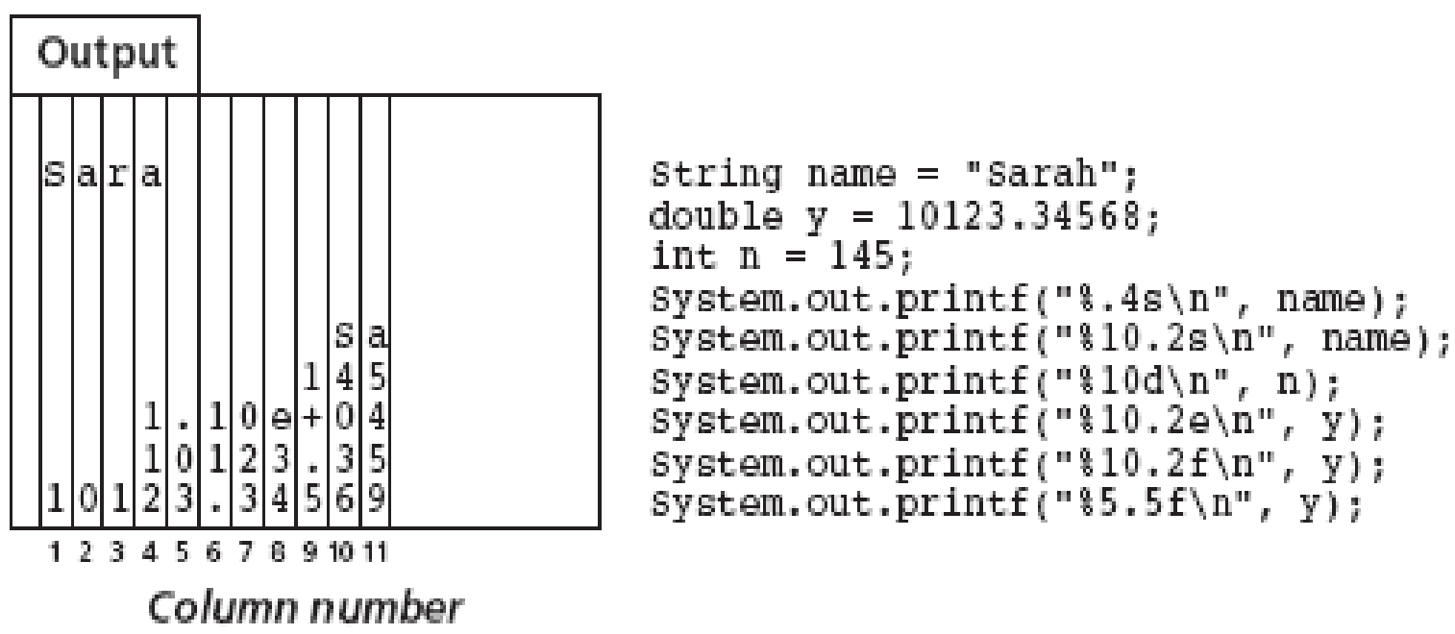
Output
Figure 1-10 Formatting example with printf
© 2011 Pearson Addison-Wesley. All rights reserved
1-‹#›
Notes:
‹#›

Slide 54
Summary
Java packages
Provide a mechanism for grouping related classes
import statement
Required to use classes contained in other packages
Object in Java is an instance of a class
Class
Data type that specifies data and methods available
Data fields are either variables or constants
Methods implement object behavior
Method parameters are passed by value
© 2011 Pearson Addison-Wesley. All rights reserved
1-‹#›
Notes:
‹#›

Slide 55
Summary
Comments in Java
Comment lines
Multiple-line comments
Java identifier
Sequence of letters, digits, underscores, and dollar signs
Primitive data types categories
Integer, character, floating point, and boolean
Java reference
Used to locate an object
© 2011 Pearson Addison-Wesley. All rights reserved
1-‹#›
Notes:
‹#›

Slide 56
Summary
Define named constant with final keyword
Java uses short-circuit evaluation for logical and relational expressions
Array
Collection of references that have the same data type
Selection statements
if and switch
Iteration statements
while, for, and do
© 2011 Pearson Addison-Wesley. All rights reserved
1-‹#›
Notes:
‹#›

Slide 57
Summary
String
Sequence of characters
String classes: String, StringBuffer, StringTokenizer
© 2011 Pearson Addison-Wesley. All rights reserved
1-‹#›
Notes:
‹#›

Slide 58
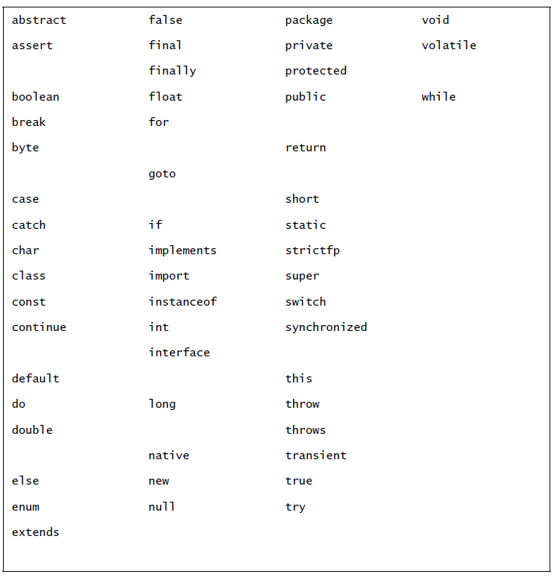
Summary
© 2011 Pearson Addison-Wesley. All rights reserved
1-‹#›
Notes:
‹#›

